Slide 1
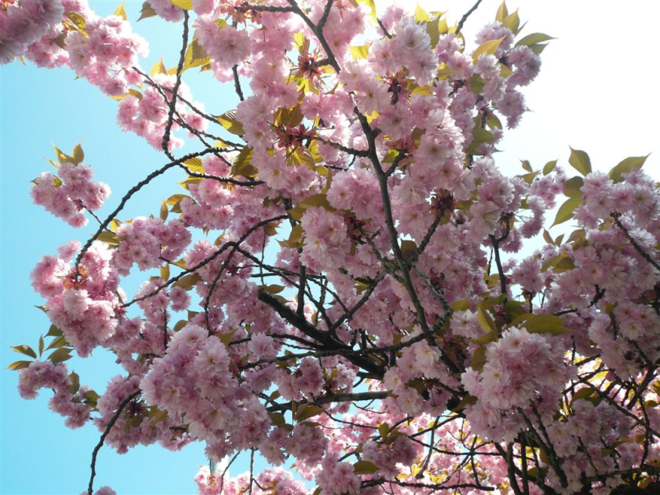
Barbaratag
Celebrated the 4th of December

Slide 2
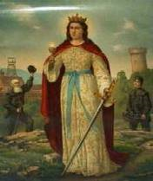
Wer war Sankt Barbara?
A Christian Auxiliary Saint, St. Barbara was said to have been born in what is now Turkey.
She died in 306 AD.
Her existence has not been scientifically or historically confirmed.

Slide 3
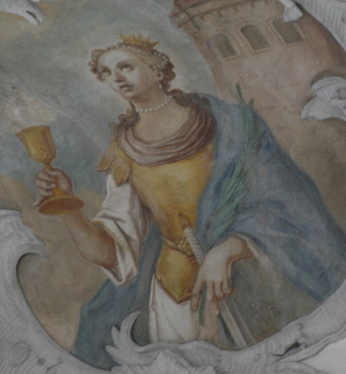
Die Legende
Saint Barbara, who was said to be beautiful and intelligent, was locked in a tower by her father, who forbade her from practicing Christianity. She held fast to her belief.
Her father had her tortured, but she remained true to her faith. He was so angry that he himself beheaded her.
Barbara’s evil father was struck and killed by lightening on his way home.

Slide 4
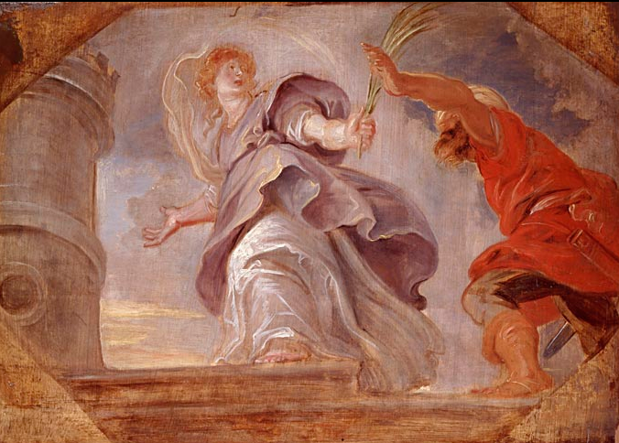
Barbara in Art
Saint Barbara flees from her father, by Peter Paul Rubens (c. 1620)

Slide 5
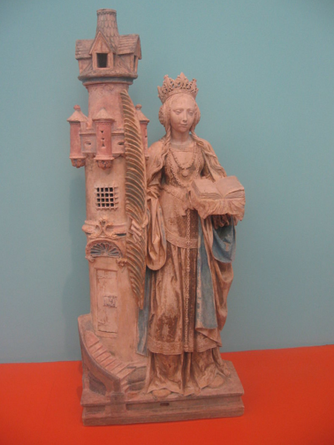
Barbara in Art
Saint Barbara and her tower, French, (Villeloup, Aube) ca 1520–30

Slide 6
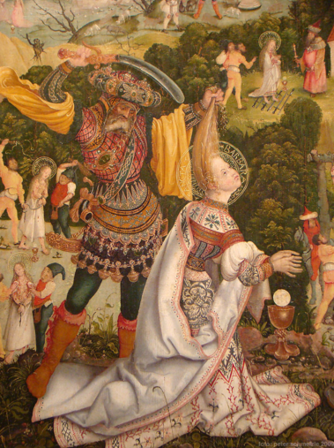
Barbara in Art
Enthauptung Barbaras durch ihren Vater Dioscuros, Barbara-Altar von Jerg Ratgeb in der Stadtkirche Schwaigern, 1510

Slide 7
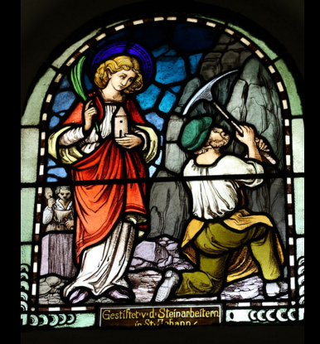
Barbara in Art
Barbara als Beschützerin der Bergleute in der Kirche St. Johannes Baptist in Sankt Johann (bei Mayen), Glasfenster

Slide 8
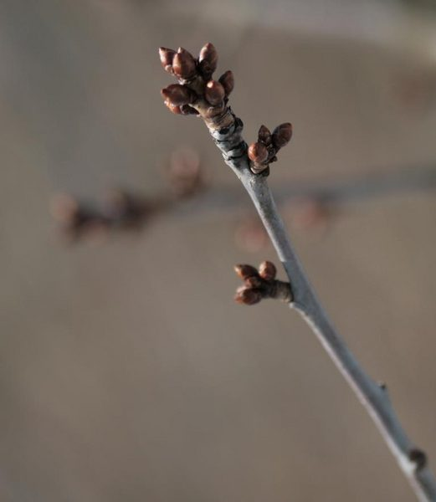
Barbarazweig
4th of December
24th December
According to the legend, a branch of a cherry tree got caught in her dress when she was sent to her tower.
Barbara watered the branch with water from her drinking cup, and on the day of her execution the branch bloomed.

Slide 9
Was passiert am Barbaratag?
On Barbaratag, a branch from a cherry tree is put in a vase.
The buds will be open in the warm house.
The branch should flower on the 24 of December.
If the branch blooms by Christmas day, it is said that you will have good luck in the following year.
Barbarazweig

Slide 10
Barbarataglied
"Es ist ein Ros' entsprungen,
aus einer Wurzel zart,
wie uns die alten sungen
von Jesse kam die Art.
Und hat ein Blümlein bracht
mitten im kalten Winter,
wohl zu der halben Nacht."
Kölner Flashmob: http://www.youtube.com/watch?v=BsqM8UWNiNo

