Slide 1
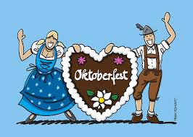
Oktoberfest 2015 Everything you need to know!

Slide 2
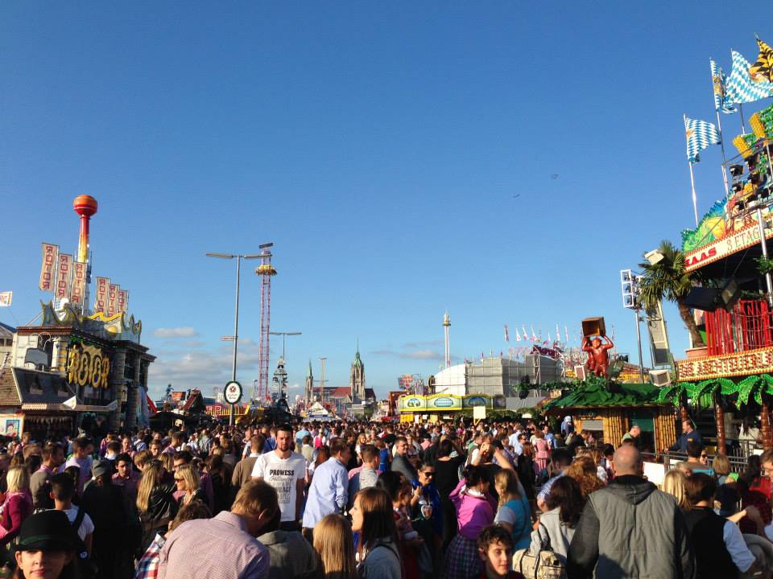
Oktoberfest is the ________________ festival in the world.
biggest

Slide 3
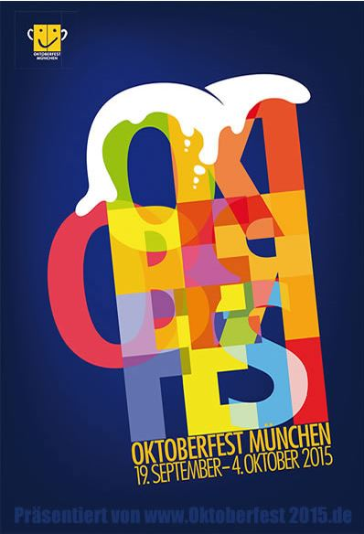
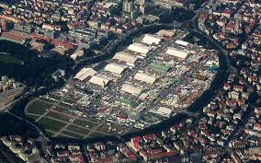
It takes place in Munich on the Wies’n. This year is the 181st Oktoberfest.

Slide 4
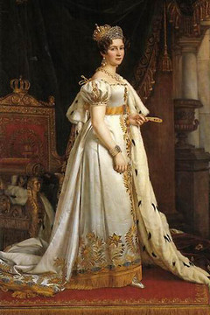
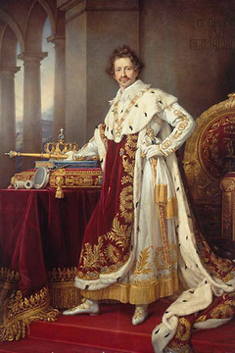
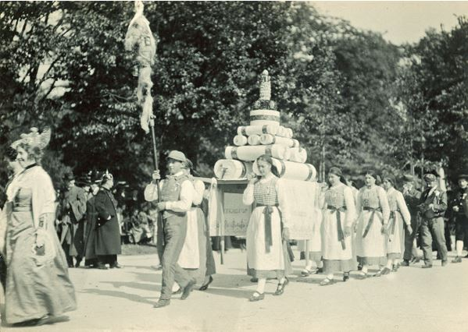
Oktoberfest started in Oktober ____________. It was a marriage celebration between King Ludwig 1 of Bavaria and Princess Theresia.
1810

Slide 5
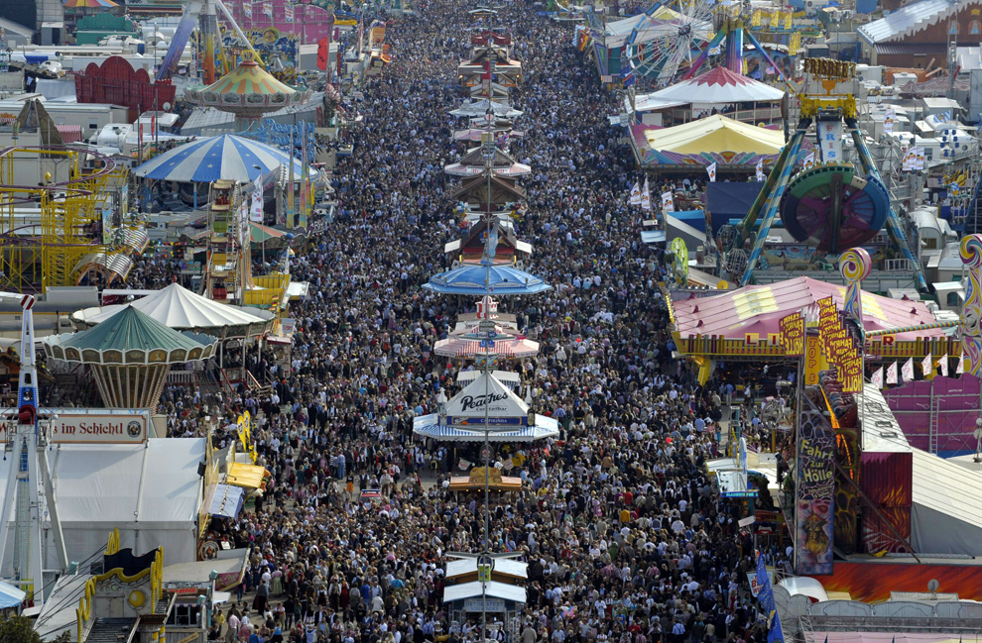
The grounds are named for Princess Theresia (Theresienwiese).
Wiese = meadow

Slide 6
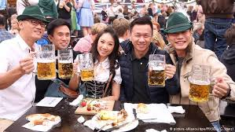
Oktoberfest is attended by ______ million people from all over the world.
six

Slide 7
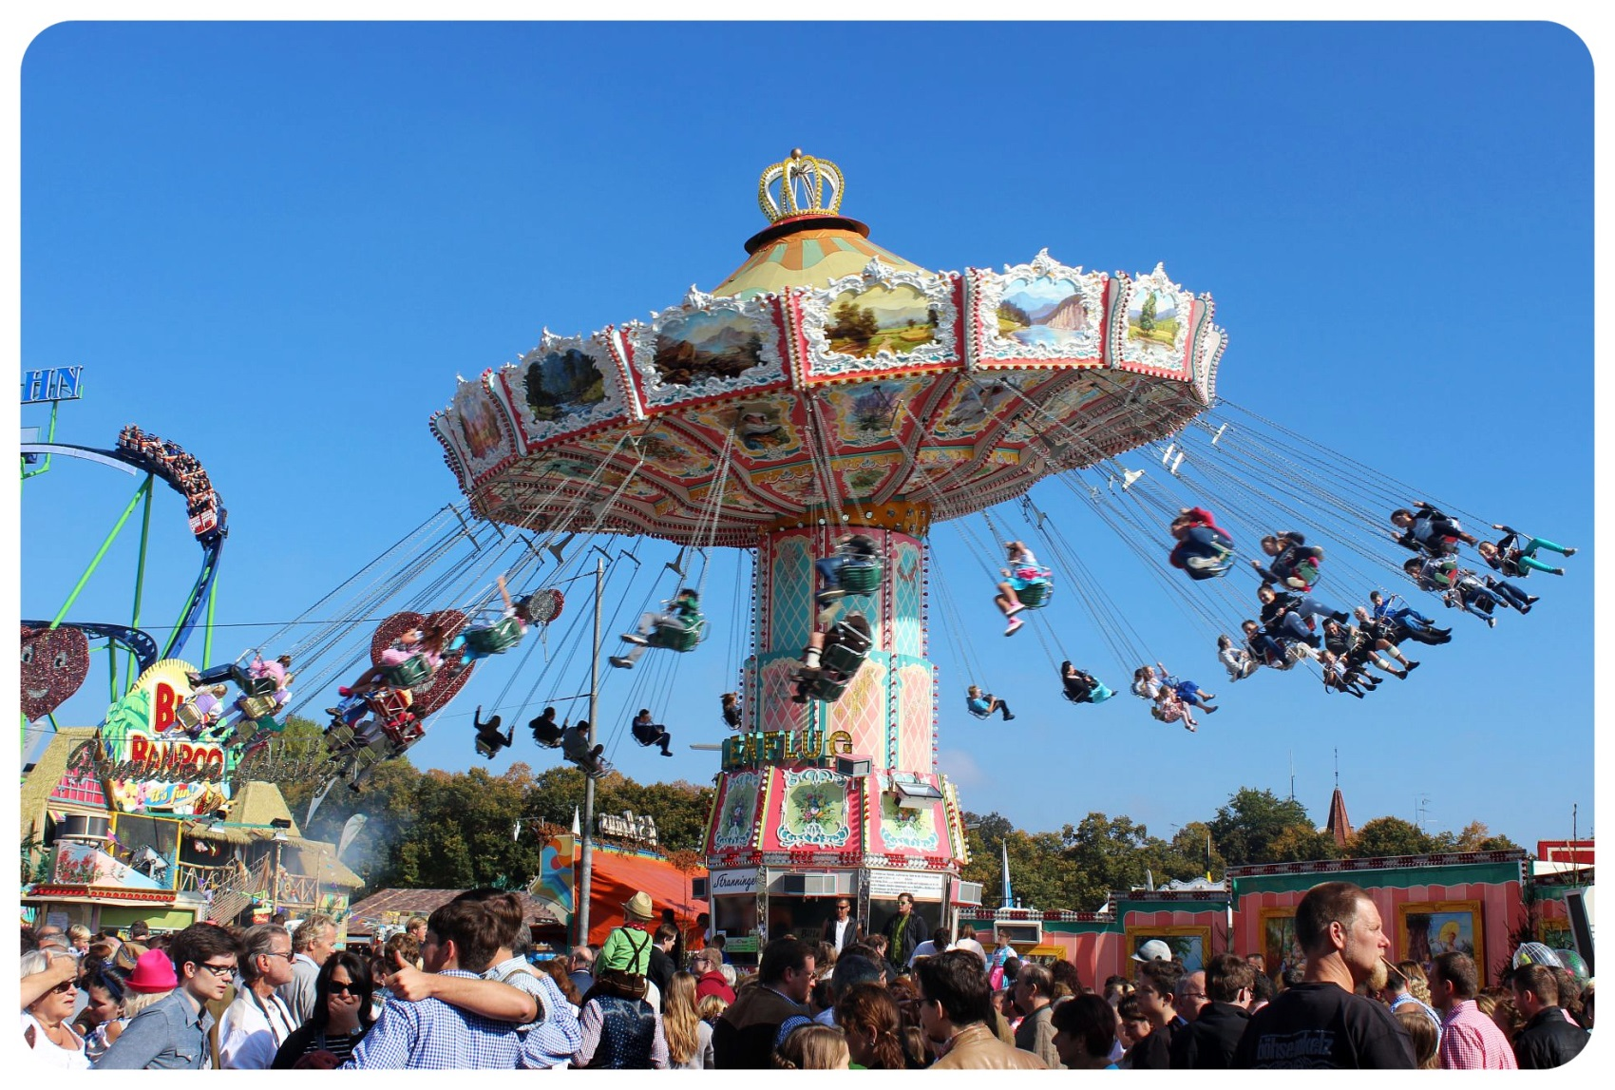
Oktoberfest is now in September because of the _______________. The fest always ends on the 1st _______________ in October.
weather
Sunday

Slide 8
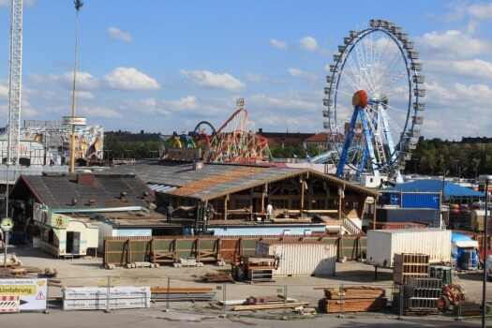
It takes ___________ months for workers to construct the massive beer tents and __________ month to take it all apart.
two
one

Slide 9
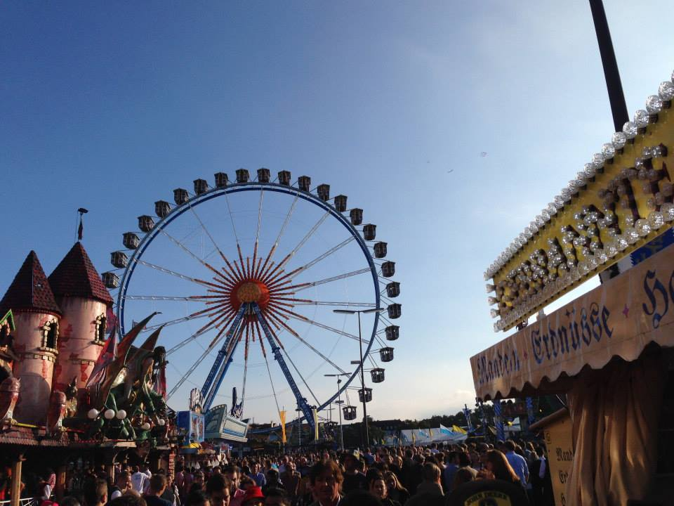
Oktoberfest lasts for ______ weeks.
two

Slide 10
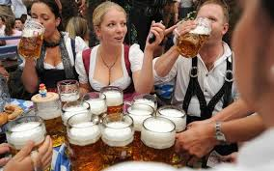
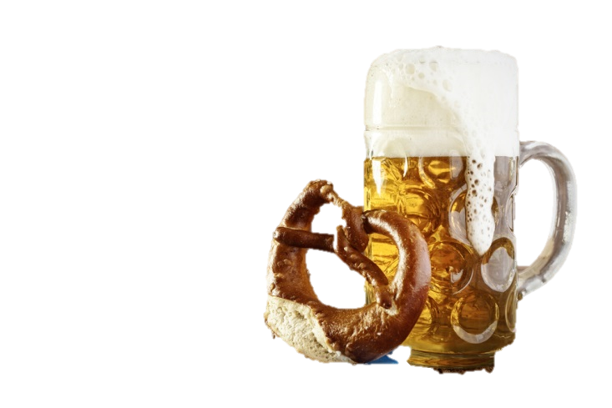
The people attending Oktoberfest consume an average of ________ million liters of beer (Bier)…
six

Slide 11
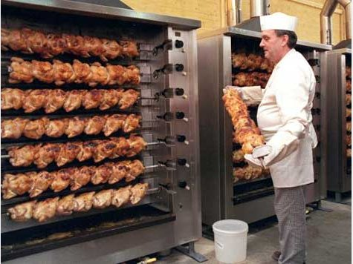
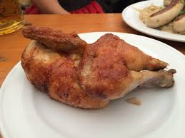
…_____________ thousand roasted chickens (Handl)…
four hundred

Slide 12
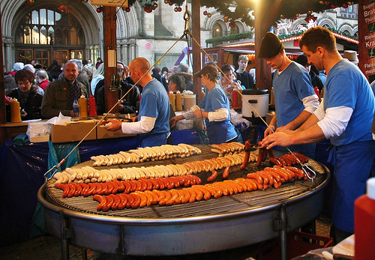
… and ______________ thousand sausages (Wurst).
two hundred

Slide 13
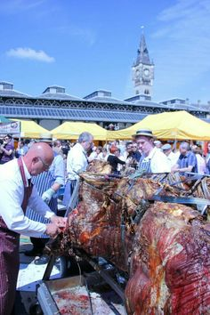
There are also whole oxen roasting over open fires…

Slide 14
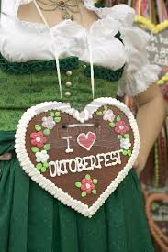
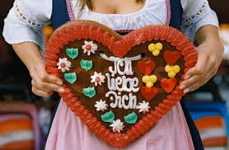
…and sentimental Lebkuchenherzen (gingerbread hearts) to be hung around a loved ones neck.

Slide 15
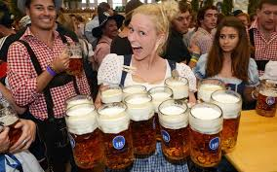
Beer is served in a Maß. A Maß (or Stein) weighs an average of _______ pounds, and costs an average of 10€ each.
five

Slide 16
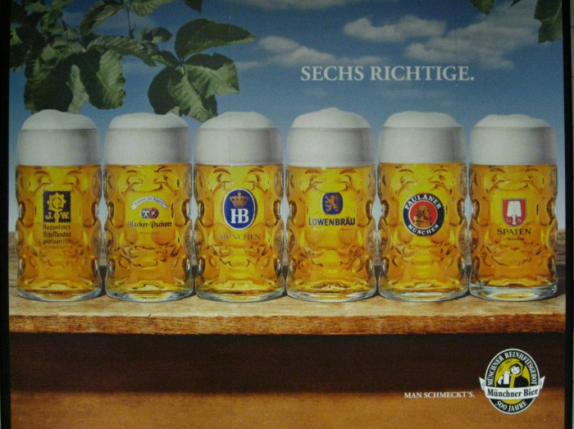
Beer at Oktoberfest is made by ___________ Munich breweries. They are Augustiner, Hofbräu, Löwenbräu, Spaten, Paulaner, and Hacker-Pschorr.
six

Slide 17
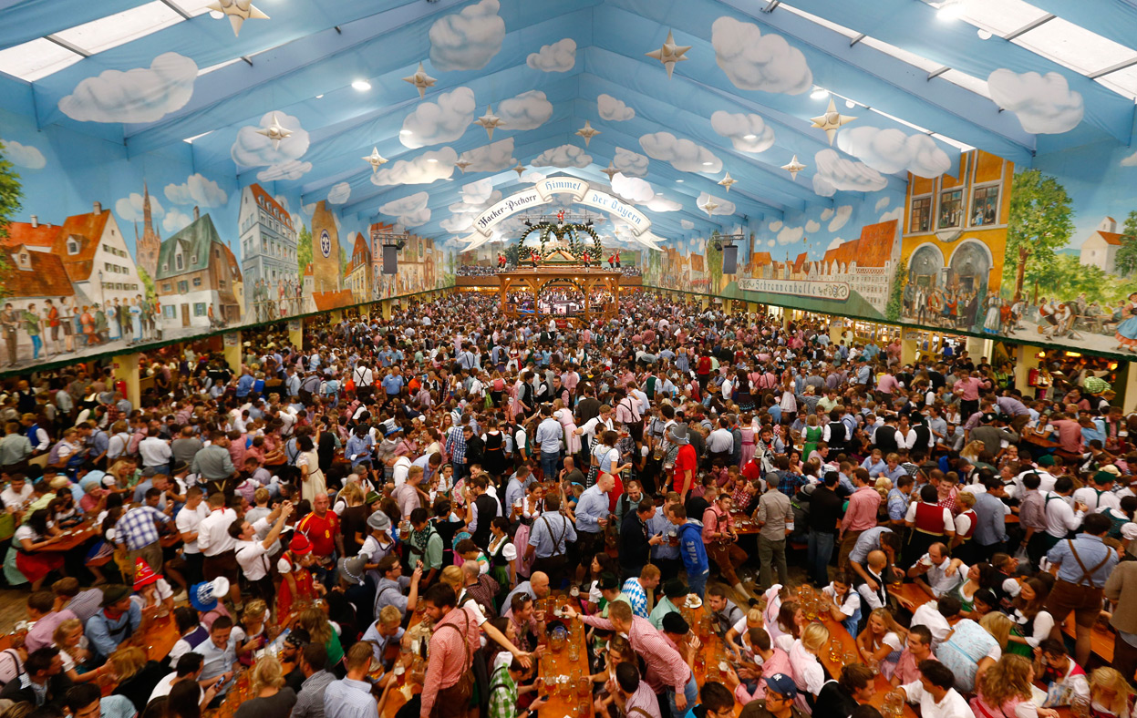
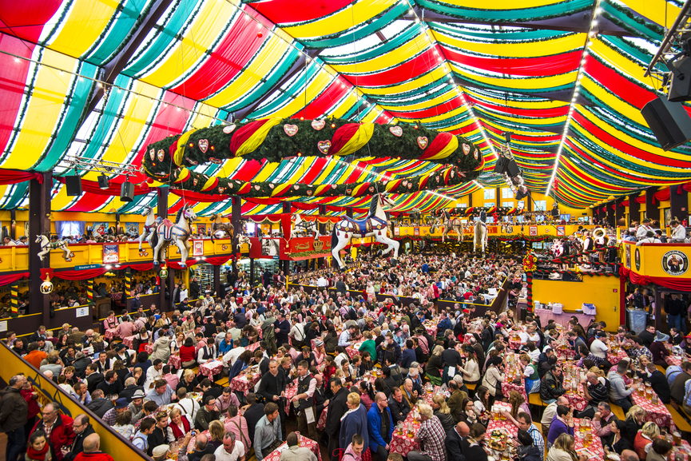
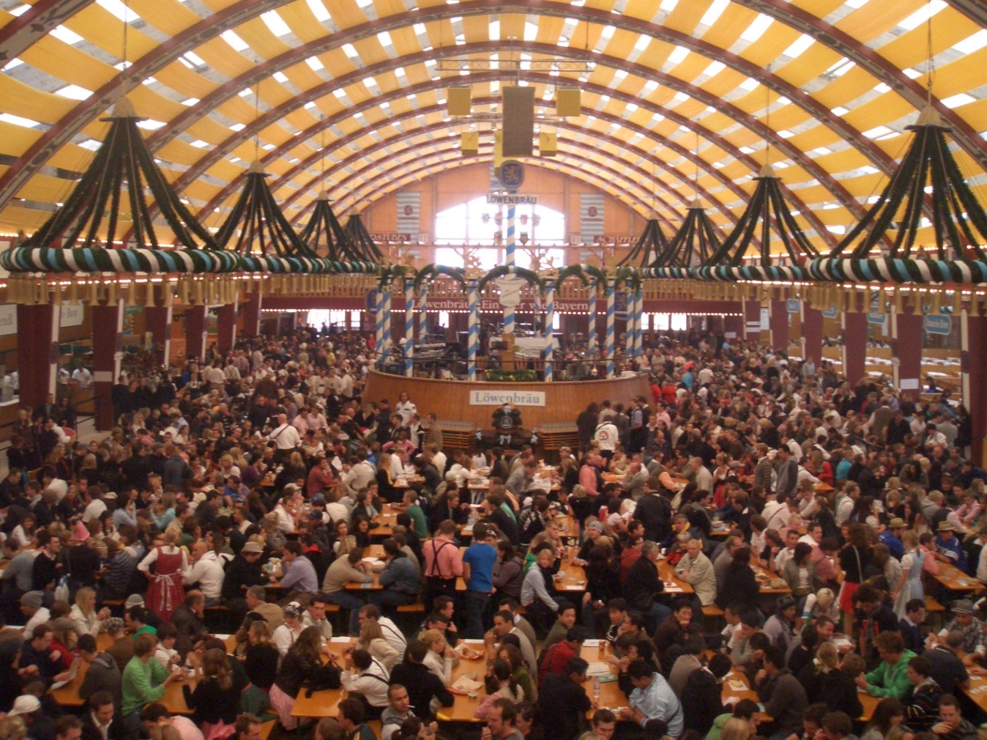
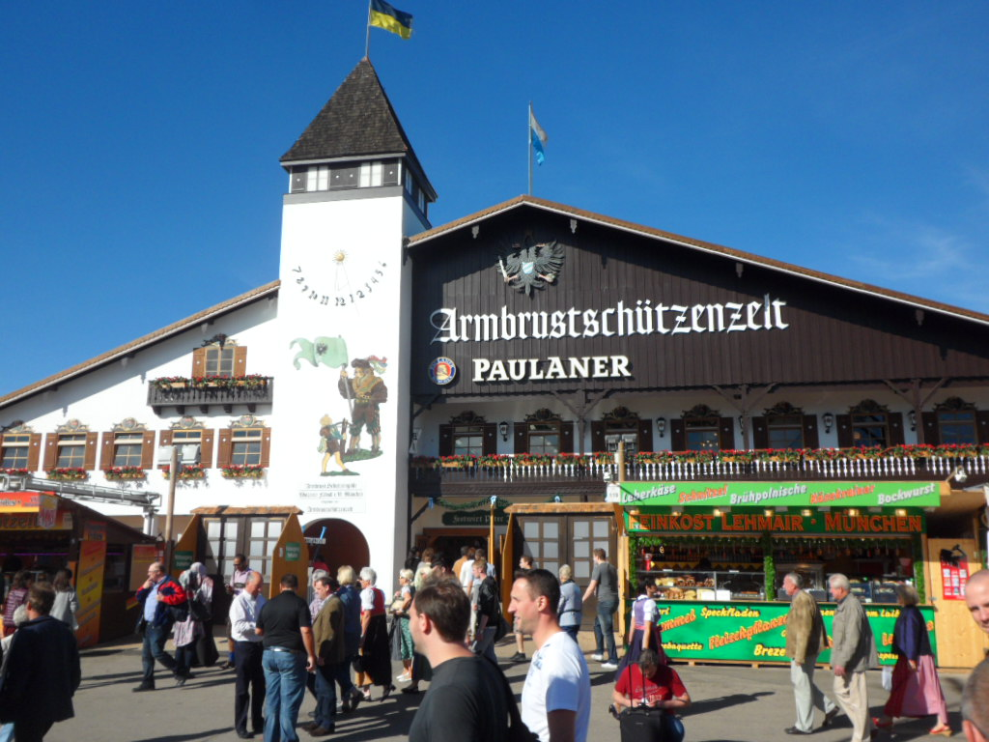
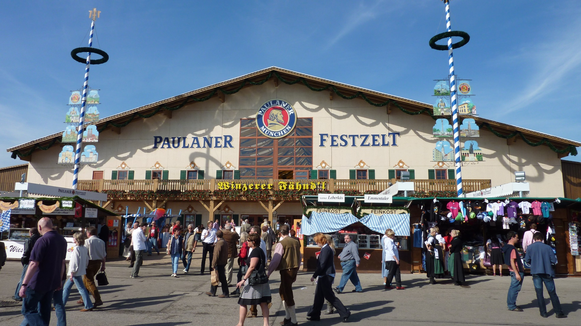
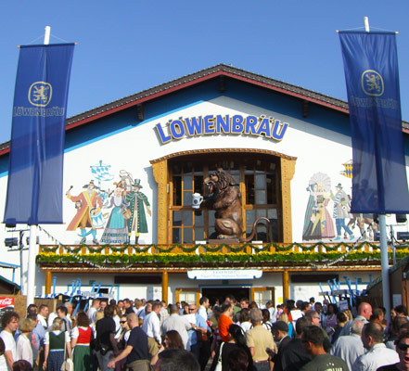
Each brewery usually has _________ tents. Each tent holds an average of _________ thousand people.
two
five

Slide 18
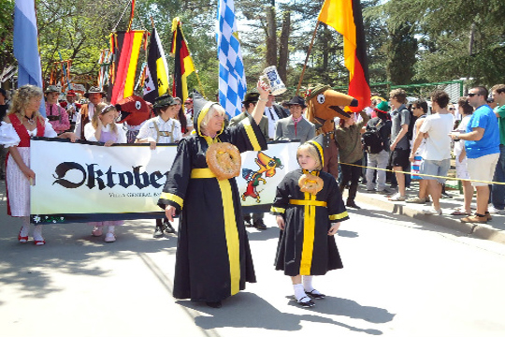
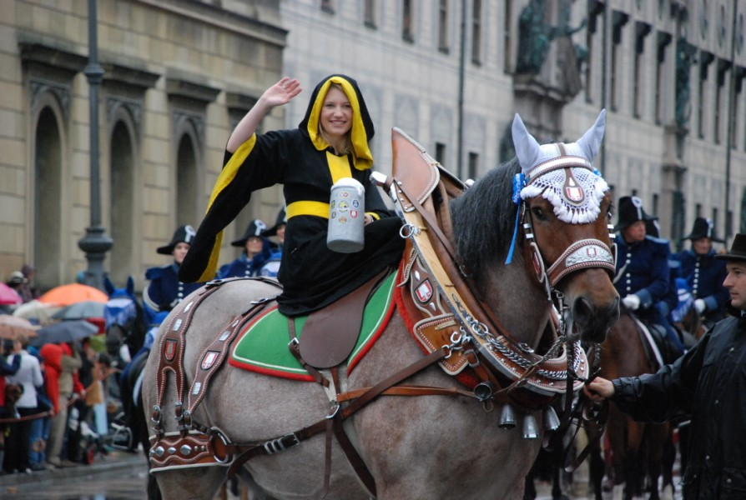
Oktoberfest starts with a ________ hour long parade led by the Müchner Kindl (a “child” dressed in a green and yellow robe).
one

Slide 19
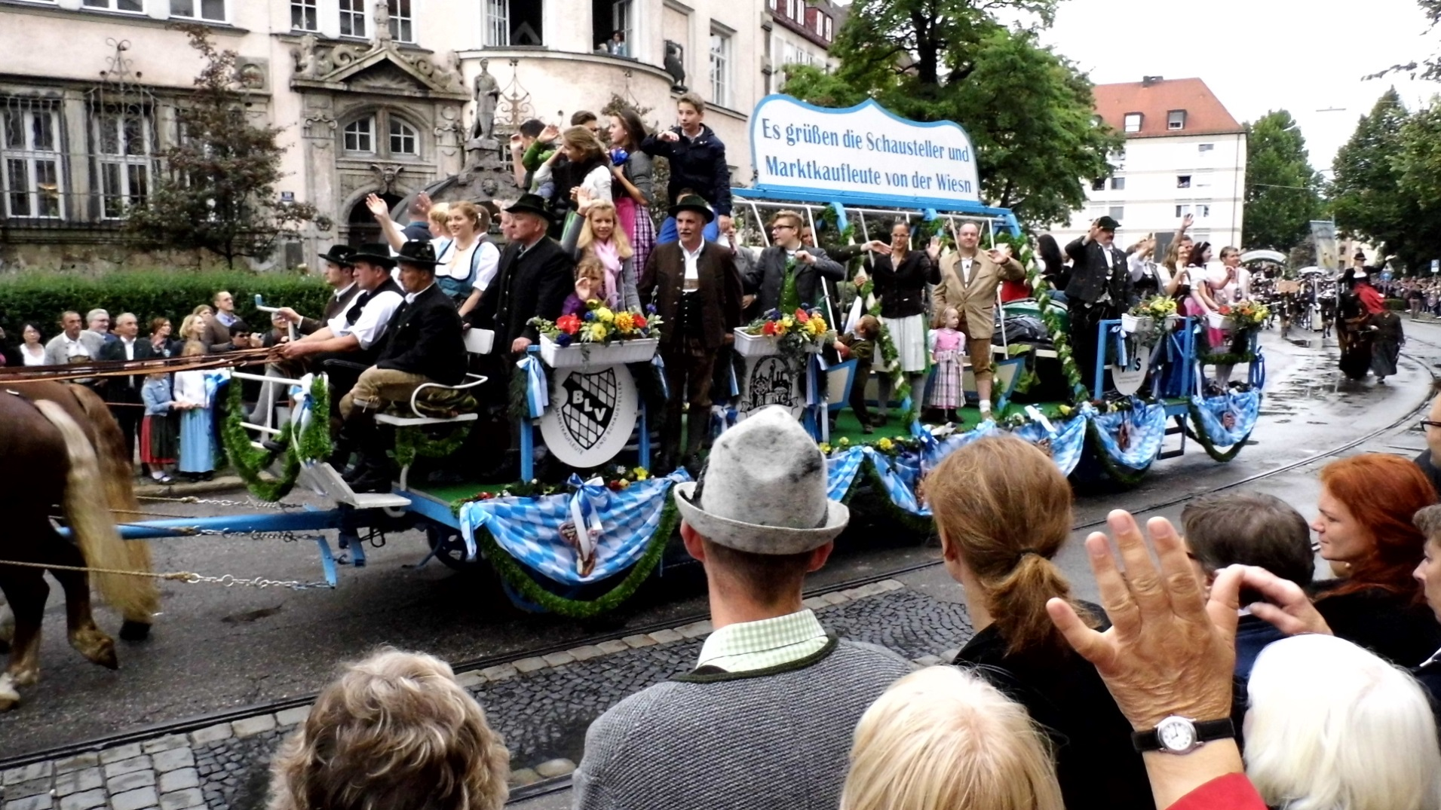
The wagons hold the brewery owners, as well as their family, friends, and staff.

Slide 20
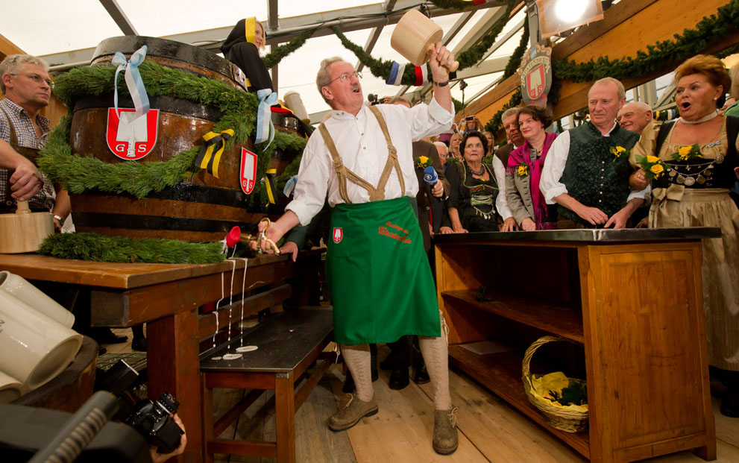
At the stroke of noon the __________________ of Munich will tap the first keg. He announces “O’zapft is!” (It’s tapped!)
mayor

Slide 21
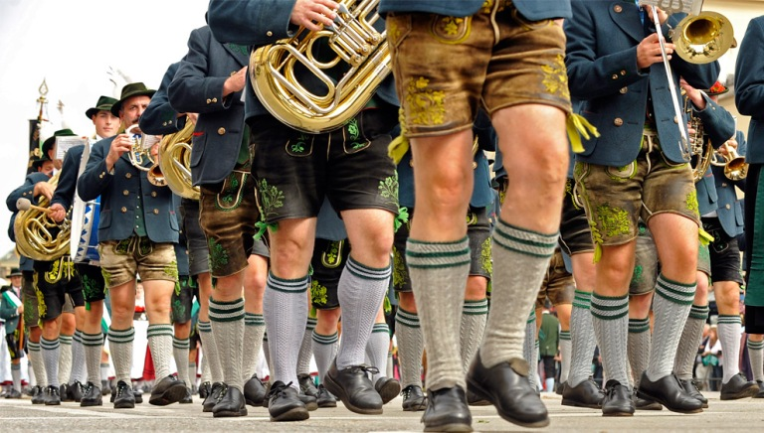
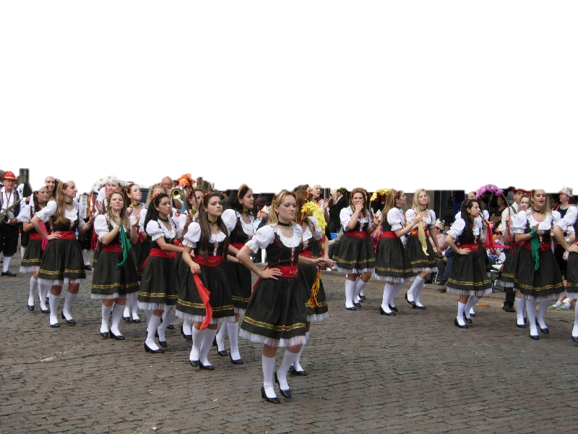
The second day opens with a parade of ____________ hundred participants in traditional clothing.
sixty-five

Slide 22
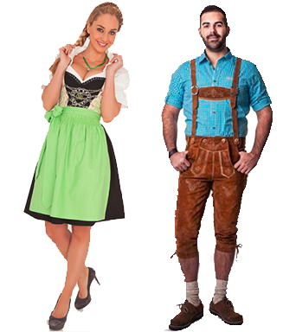
A woman wears a dirndl, which has a tight bodice, full skirt and fanciful design elements. A man would wear lederhosen, leather shorts worn with high wool socks.

Slide 23
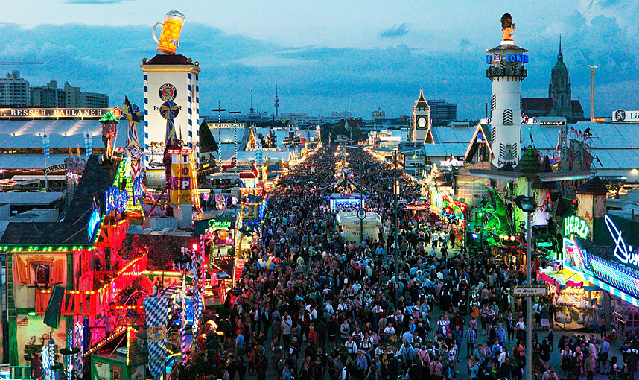
There are over ______________ thousand visitors every day to Oktoberfest.
one hundred

