Slide 1
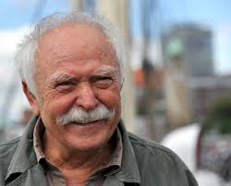
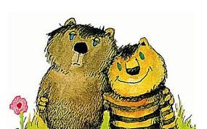
Janosch

Slide 2
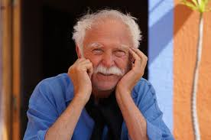
Janosch
Janosch’s real name is
Horst Eckert.
He was born March 11, 1931.
He is one of the best-known German artists and children's book authors.

Slide 3
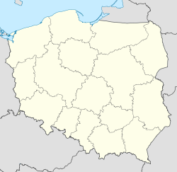
Janosch
He was born in Hindenburg (now Zabrze, Poland) in Upper Silesia to a family of mixed German and Polish heritage.
He said in an interview
that he is Silesian and
that it is his nationality.
Zabrze

Slide 4
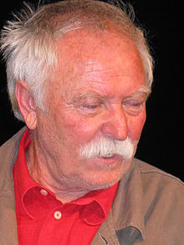
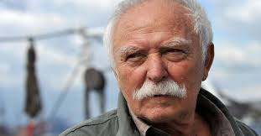
Janosch
His family fled to West Germany after WWII.
In 1960 his first book for children was published with George Lentz, who was a friend of his, who also persuaded him to take on the penname Janosch.

Slide 5
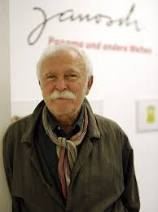
Janosch
He also published books for
adults, with the recurring topics
friendship, family relationships and the quest for the meaning of life.
Among others, he has
received the following
awards: the Literature Award
of the City of Munich, and
the German Youth Literature
Award.

Slide 6
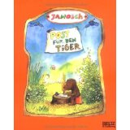
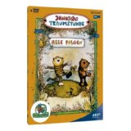
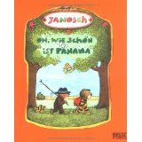
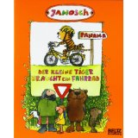
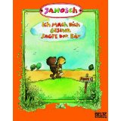
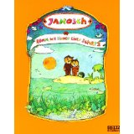
Janosch
By 1980 he had published over
100 books for children in nearly 30 languages.

Slide 7
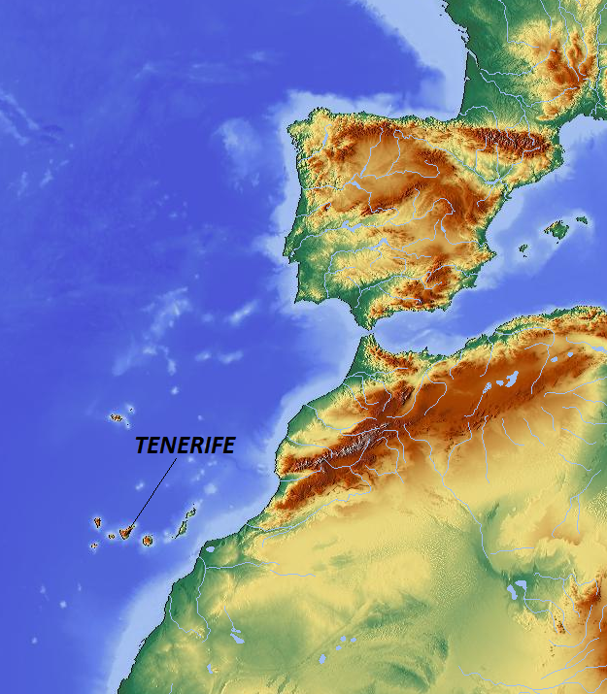
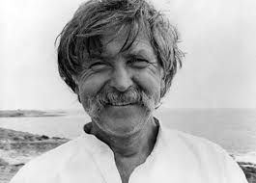
Janosch
He now lives on the island of Tenerife in the
Atlantic Ocean.
SPAIN
AFRICA

Slide 8
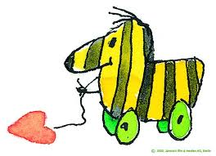
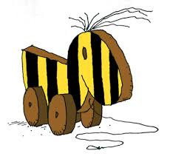
Janosch
His most famous character,
the “Tigerente” appears in
almost all of his books and
never once has a line of dialogue.

Slide 9
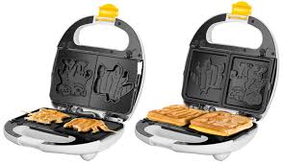
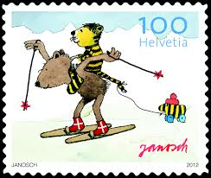
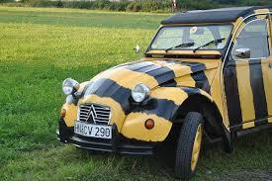
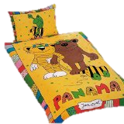
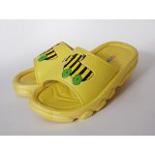
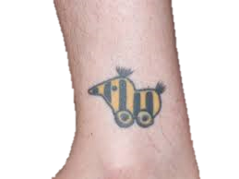
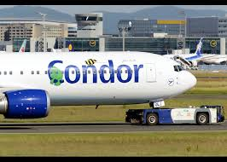
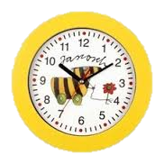
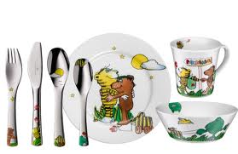
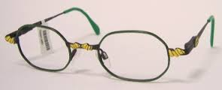
Janosch
The Tigerente has since
appeared on a wide range of products including:

Slide 10
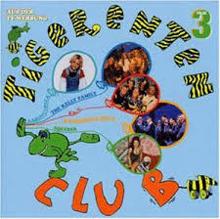
Janosch
The Tigerente even
inspired a German children’s
TV show: Die Tigerenteclub.

Slide 11
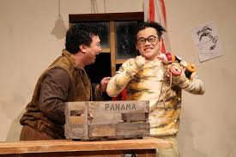
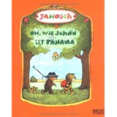
Janosch
Oh Wie Schön Ist Panama is
one of the most beloved children’s books in Germany. It was written in 1978.
It was even made into an Opera in Berlin in 2013. It sold out.

