Slide 1
UW in the High School

Slide 2
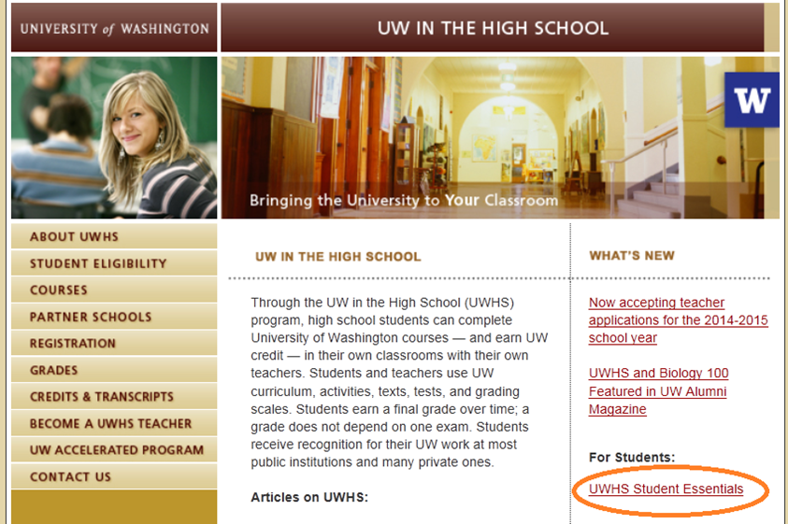
UWHS Website
http://www.uwhs.washington.edu/uwhs/

Slide 3
Program Highlights
Oldest such program in Washington (1981)
Available to all Washington high schools
Stats for 2014-15
18 subject areas
92 high schools
201 teachers
3,555 students
4,307 registrations

Slide 4
How the Program Works
Highly qualified teachers
Approved, trained, supported by UW departments
Official UW courses
In the high school classroom
Eligible students can register to earn UW credit; all students awarded high school credit
Fee-based, self-sustaining program
Partnership!

Slide 5
National Standards and Accreditation
17 Standards established to ensure program quality
UWHS accredited 2007-2014, reaccredited 2014-2021
Examples of Standards:
End-of-course evaluations
Faculty site visits
Annual survey of students

Slide 6
Comparing to Other Models
 | Costs to the student | Costs to the school | Student stays at the high school | Student earns a grade over the whole course
Advanced Placement | $91 Test, reduced cost available | Various fees, Registration for professional development
Running Start | Books, Travel/Parking, Fees | Portion of student FTE may go to the college
UW in the High School | $325 Course Fee + $45 Registration Fee | Textbooks (if required for a course)

Slide 7
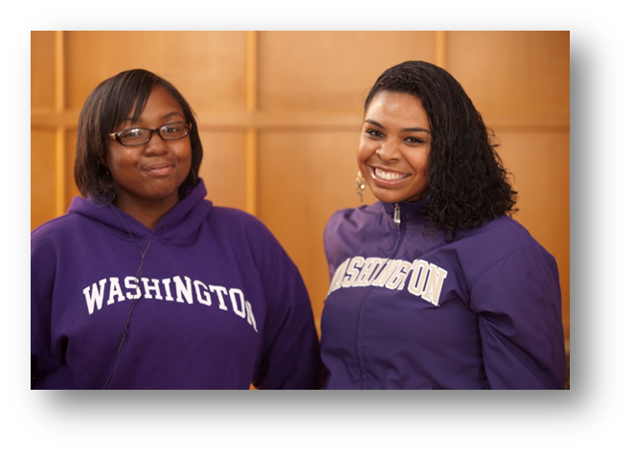
Student Eligibility
10th, 11th and 12th grade students are eligible to register for UW credit
RCW 28A.600.290
College in the high school program
B+ in subject area, or permission of instructor
Some courses have prerequisites
Ex: French 103 requires completion of two years of high school-level French

Slide 8
Registration Fees and Deadlines
Registering for UW credit is optional
For 2015-16, at least 4 students must register for UW credit
There are no payment plans, reduced fee options, or deadline extensions
Fees | 2015-16
Course Fee | $325
Registration Fee | $45
TOTAL | $370
Course Start | Approximate Registration Deadline
Fall-start (year-long and first semester only courses | End of October
Second semester only courses | Early March

Slide 9
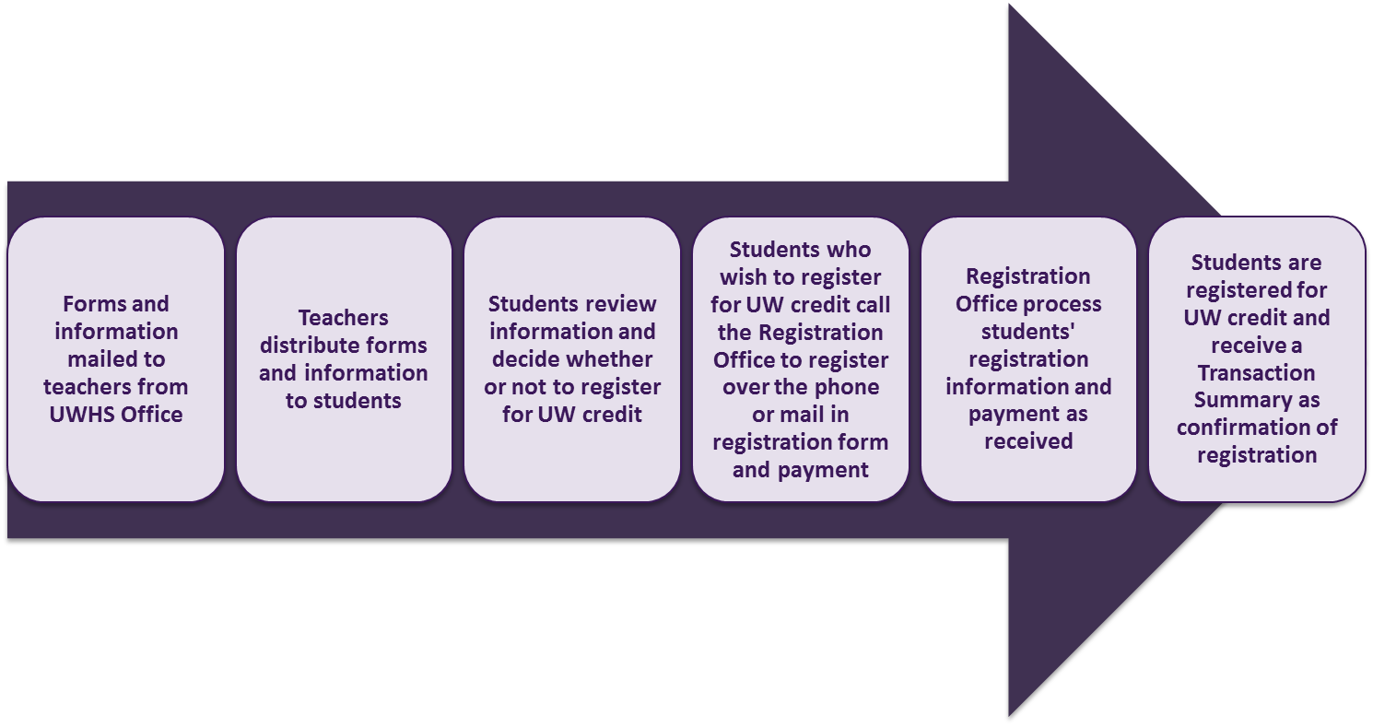
Registration Process

Slide 10
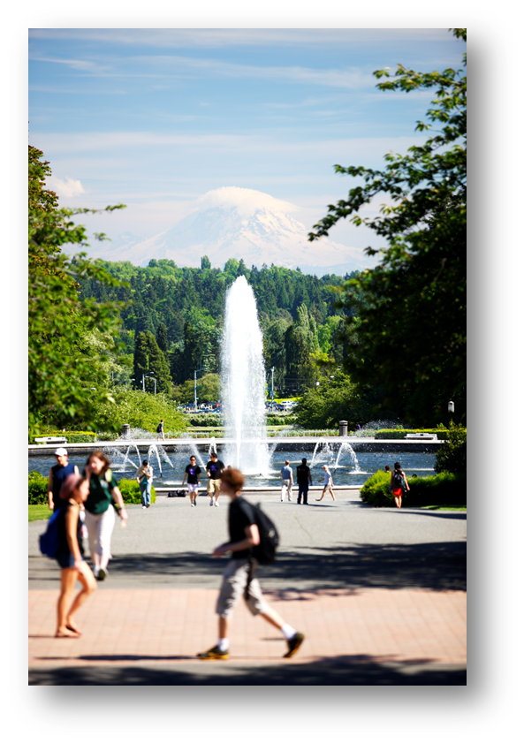
Benefits to Students
Experience an official UW course in the high school classroom
Access the UW libraries
Establish a UW transcript
Earn UW credit at a fraction of on-campus rates
93% of responders in the most recent alumni survey would recommend UWHS to current students!

Slide 11
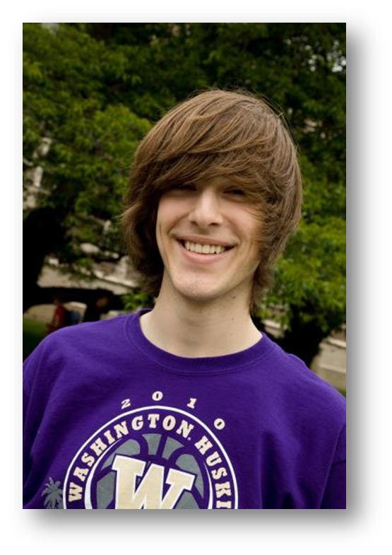
UWHS Student Performance
Average grade - 3.2 (B+)
% of UWHS grades > 2.0 - 93%
% of students to UW - 10%
Their average UW GPA - 3.3
Note: No specific UW admission advantage for UWHS students.

Slide 12
Transferring Credit in Washington
Generally DO Accept Credit:
Bellevue College
Central Washington University
Eastern Washington University
Evergreen State College
Gonzaga University
Heritage University
Pacific Lutheran University
Saint Martin’s University
Seattle Pacific University
Seattle University
Walla Walla University
Washington State University
Western Washington University
Whitworth University
All Community Colleges
Generally DON’T Accept Credit:
University of Puget Sound
Whitman College
For out-of-state institutions, students should contact their prospective college or university to inquire. From anecdotal information, most public and many private institutions accept the credits.

Slide 13
Courses Offered through UWHS
Official UW courses in the UW course catalog
Sponsored and supported by an academic department
Fulfill UW graduation requirements
Course | Natural World | Individuals & Society | Quantitative & Symbolic Reasoning
BIOL 100 | X
CSE 120 | X |  | X

Slide 14
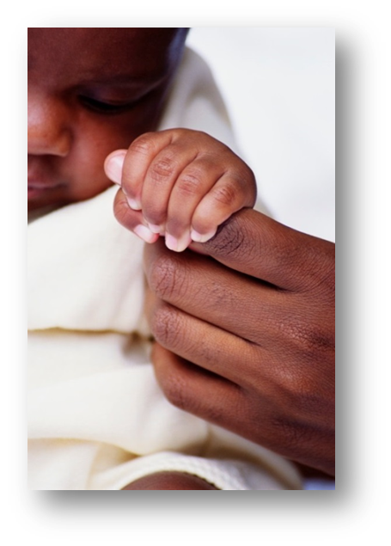
Humanities & Social Sciences
ENGL 111
Composition: Literature
ENGL 131
Composition: Exposition
C LIT 240
Writing in Comparative Literature
PSYCH 101
Introduction to Psychology
G H 101
Introduction to Global Health: Disparities, Determinants, Policies and Outcomes

Slide 15
Math & Computer Science
MATH 120
Precalculus
MATH 124
Calculus I
MATH 125
Calculus II
CSE 120
Computer Science Principles
CSE 142
Computer Programming I
CSE 143
Computer Programming II

Slide 16
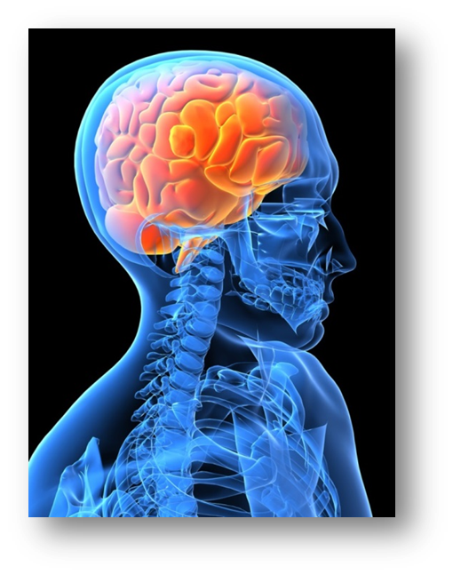
Science
New!
ASTR 101
Astronomy
ASTR 150
The Planets
ATM S 111
Global Warming
BIOL 100
Introductory Biology: Addiction and the Brain
BIOL 118
Survey of Physiology
CHEM 110
Introduction to Chemistry

Slide 17
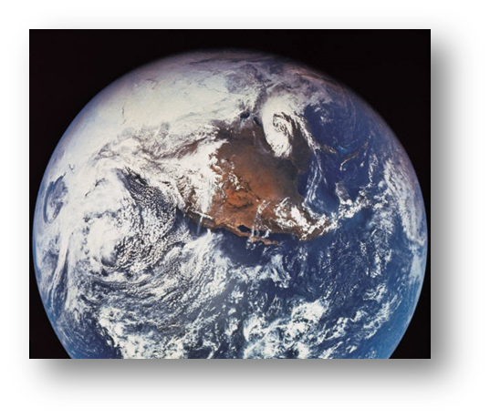
Science
New!
ESRM 101
Forests and Society
ESRM 150
Wildlife in the Modern World
ESS 101
Introduction to Geological Sciences
ESS 102
Space and Space Travel
OCEAN 101
Survey of Washington Waters
New!
New!

Slide 18
World Languages
FRENCH 103
Elementary French
GERMAN 103
Elementary German
GERMAN 201
Second-Year German
JAPAN 113
First-Year Japanese
KOREAN 101
First-Year Korean
LATIN 103
Elementary Latin
SPAN 103
Elementary Spanish
SPAN 201
Intermediate Spanish
SPAN 202
Intermediate Spanish

Slide 19
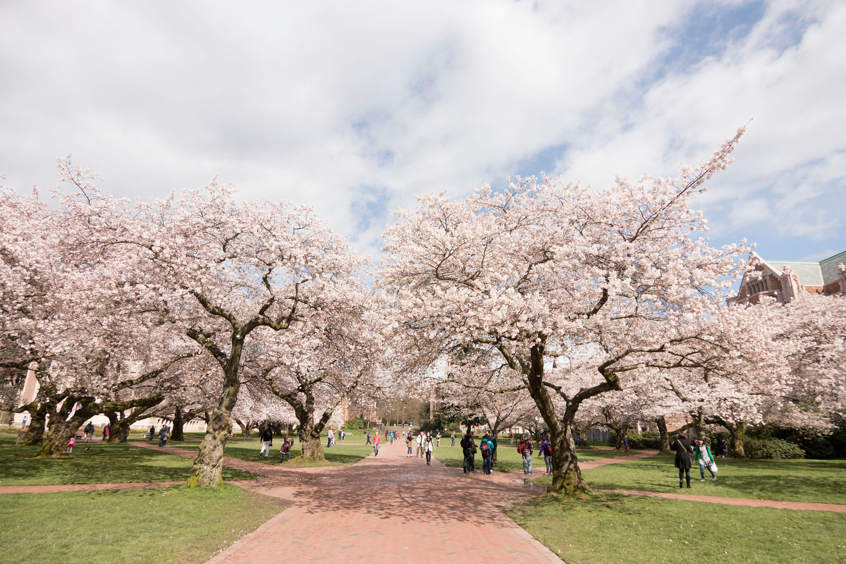
UW in the High School
www.uwhs.washington.edu

