Slide 1
GAPP 2019 Hosting Meeting
Please sign in and grab a packet!

Slide 2
Contact Information:
Remind.com ➡
Enumclaw Area Map
& Phone Tree
Frau’s phone number
(for emergencies!)
--- --- -----

Slide 3
Airport Information:
Pick Up:
Saturday, March 30th, 4:30 PM Baggage Claim
Drop Off:
Friday, April 19th, 2:30 PM at SeaTac

Slide 4
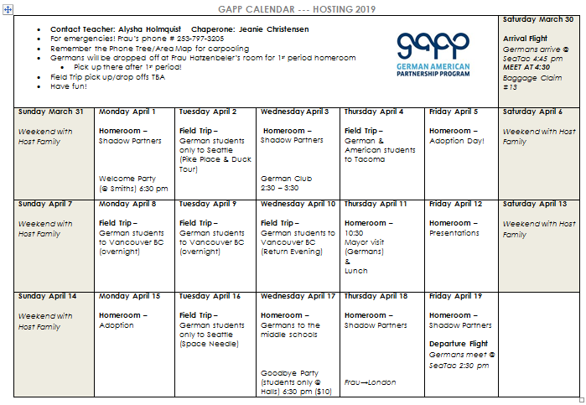
Hosting Calendar (green):

Slide 5
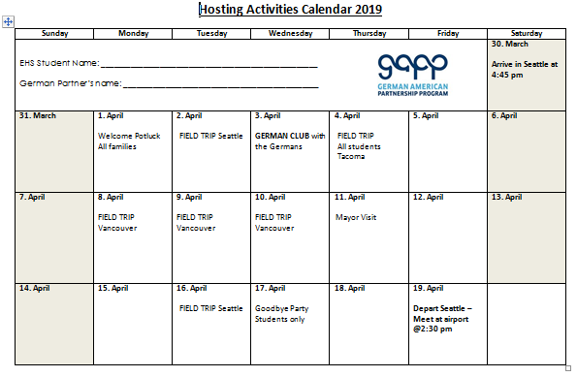
Activity Calendar (blue):

Slide 6
GAPP Handbook:
https://frauholmquist.weebly.com/gapp-2019-hosting-information.html

Slide 7
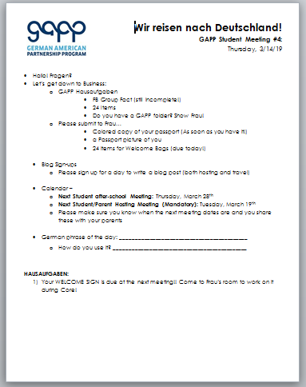
GAPP Classes:
MANDATORY! :)
For a grade on your transcript!
Prepping for abroad!

Slide 8
GAPP Hosting Blog:
https://enumclawhighschoolgapp2019.weebly.com/

Slide 9
Passports:
Name correct?
Colored Photocopy Due by 5/30

Slide 10
Questions?

Slide 11
Bis bald!
See you soon!
Sat, 3/30
@ 4:30 PM
Next GAPP parent Meeting!
(mandatory travel meeting!)
Tuesday, June 4th at 6:00 pm

